Slide 1
Smart Login
Using
Web Service
[Group no :35]

Slide 2
Project Guide :-
Mr. Gopal Gupta
Group Members :-
Tarun Mirani 145
Poojan Kothari 155
Romit Jain 154
Domain :-
Data Security & Web Service

Slide 3
IEEE Papers
S3PAS:A Scalable Shoulder-Surfing Resistant Textual-Graphical Password Authentication Scheme
- Huanyu Zhao and Xiaolin Li
Symmetric key Cryptographic Algorithm
-Ayushi,Lecturer
Steganographic Algorithm
- Wei Zheng
3-way authentication for Virtual locker
-Tarun Mirani

Slide 4
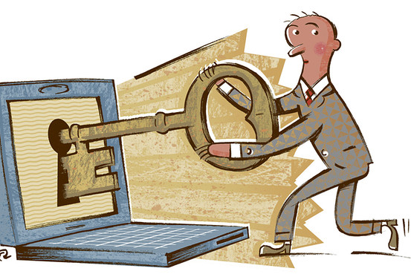
Phases Of our Project
There are 3 phases in this system are:
1. Smart Login
2. Cryptography
3. Steganography

Slide 5
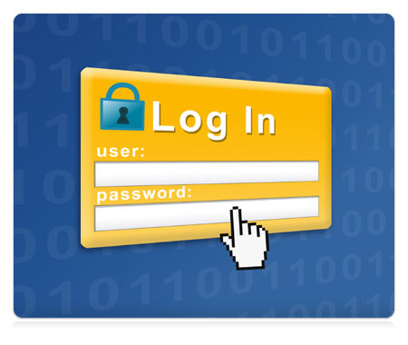
Website security and user privacy on internet has been a great concern.
Every website we visit the user logins by providing login id and password.
Smart Login

Slide 6
Disadvantages of the conventional login ID and password scheme.
If the passwords are short, then they can be easily guessed. Also there are chances that our password may get hacked.
If the password is too long, then they are hard to remember. Someone standing behind or besides you can intentionally see the password while you are typing it (SHOULDER-SURFING).
There is need for solving the above stated problem of Login. The solution is to give to the user the protection of his private data by not using simple Login id and password scheme rather using “SMART LOGIN.”

Slide 7
Working Of Smart Login

Slide 8
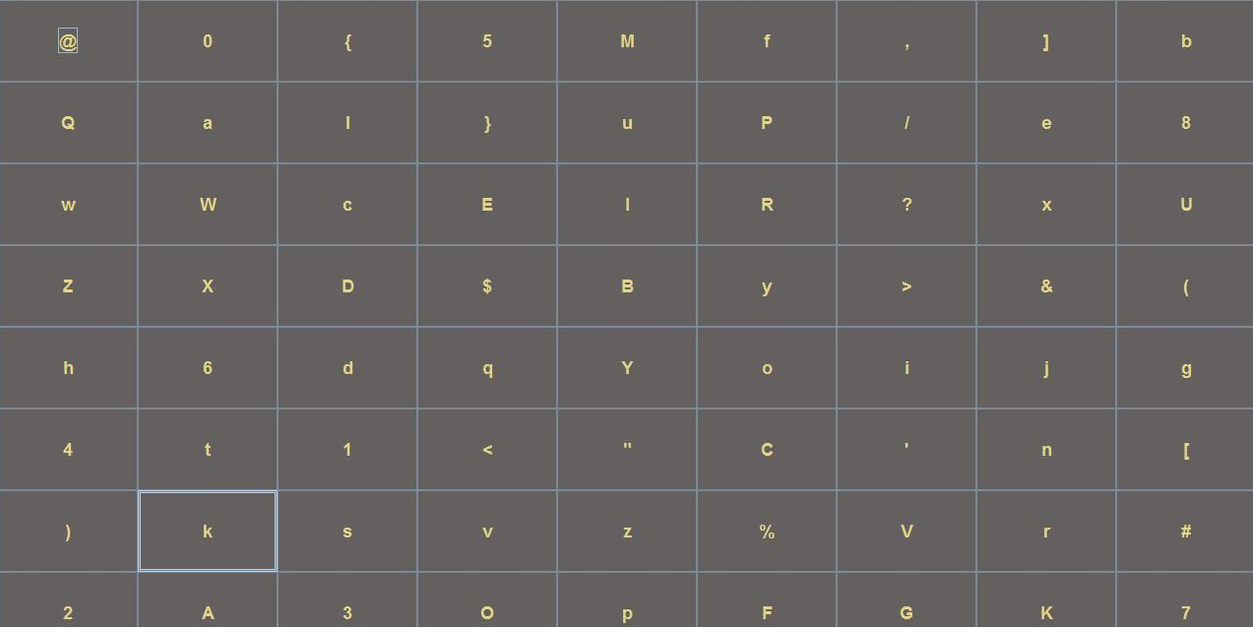

Slide 9
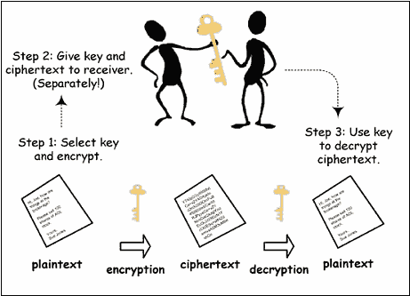
Cryptography
Cryptography is the art and science of achieving security by encoding messages to make them non-readable.

Slide 10
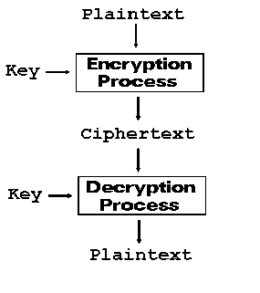
The application will provide the end-user with 2 options for encryption and decryption.
As the user types a word and selects to ENCRYPT, the cipher text should appear on the screen. The user then must also be able to decrypt the cipher text so obtained in order to retrieve back the original plain text entered by the user, by just a simple click on DECRYPT.

Slide 11
Encryption Algorithm
1. Generate the ASCII value of the letter.
2. Generate the corresponding binary value of it. [Binary value should be 8 digits].
3. Reverse the 8 digit’s binary number.
4. Take a 4 digits divisor (1000) as the Key.
5. Divide the reversed number with the divisor.
6. Store the remainder in first 3 digits & quotient in next 5 digits.
7. Reverse the binary result of step 6.
8. Generate a random key and add this key to the reversed result of Step7.
9. Reverse the 8 digit binary result obtained on addition.

Slide 12
Example:
Let the character be “T”. Now according to the steps we will get the following:
1. ASCII of “T” is 84 in decimal.
2. The Binary value of 84 is 1010100. Since it is not an 8 bit binary number we need to make it 8 bit number as per the encryption algorithm. So it would be 01010100
3. Reverse of this binary number would be 00101010
4. Let 1000 be the divisor i.e. Key
5. Divide 00101010 (dividend) by 1000(divisor)
6. The remainder would be 10 and the quotient would be 101. So as per the algorithm the result would be 01000101 in binary.
7. Now reversing the binary number, we get 10100010
8. Assuming the random key generated to be 10 ie 1010, after adding this key we get, 10101100
9. After reversing the result of previous step, as per the algorithm the cipher text would be 00110101 which is ASCII 53 in decimal i.e. “5” (The cipher text so obtained would change on every execution as the random key generated would be different).

Slide 13
Decryption Algorithm
1. Reverse the binary 8 digit number of the cipher text.
2. Subtract the random key from the reversed binary number.
3. Reverse the result of the previous step.
4. Multiply last 5 digits of the reversed binary number by the Key (1000).
5. Add first 3 digits of the reversed binary number with the result produced in the previous step.
6. If the result produced in the previous step i.e. step 5 is not an 8-bit number we need to make it an 8-bit number.
7. Reverse the number to get the original text i.e. the plain text.

Slide 14
After encrypting “T” we have got 00110101 as the cipher text. Now according to decryption algorithm let’s try to get back the original text i.e. “T”.
1. After reversing the number the result would be, 10101100.
2. Now subtract the random key i.e 10 from the reversed binary number obtaining 10100010.
3. After reversing the result again we get, 01000101.
4. After multiplying 00101 (last 5 digits of the binary number) by 1000 (Key) the result would be 101000.
5. After adding 010 (first 3 digits of the binary number) with 101000 the result would be 101010.
6. Since 101010 is not an 8-bit number we need to make it 00101010.
7. After reversing the number it would be 01010100 i.e. ASCII 84 in decimal i.e. “T” as character which was the original text.

Slide 15
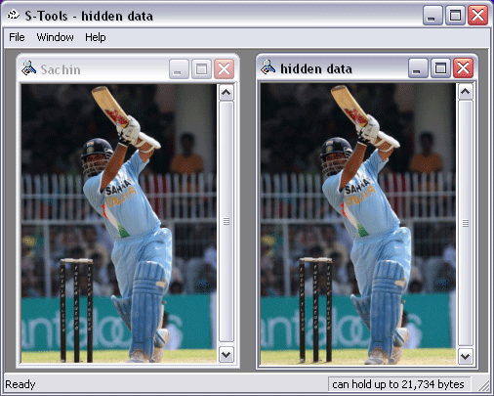
Steganography
It is the art of hiding the
fact that communication
is taking place by hiding information in other information.
The goal of steganography
is to make the transmitted information invisible by embedding the information
in cover media.
Application will achieve steganography by hiding one image into another.

Slide 16
DCT Algorithm
DCT stands for Discrete Cosine Transform.
Digital watermarking is defined as a process of embedding data (watermark) into a multimedia object to help to protect the owner's right to that object.
The embedded data (watermark) may be either visible or invisible.
In visible watermarking of images, a secondary image (the watermark) is embedded in a primary (host) image such that watermark is intentionally perceptible to a human observer.

Slide 17

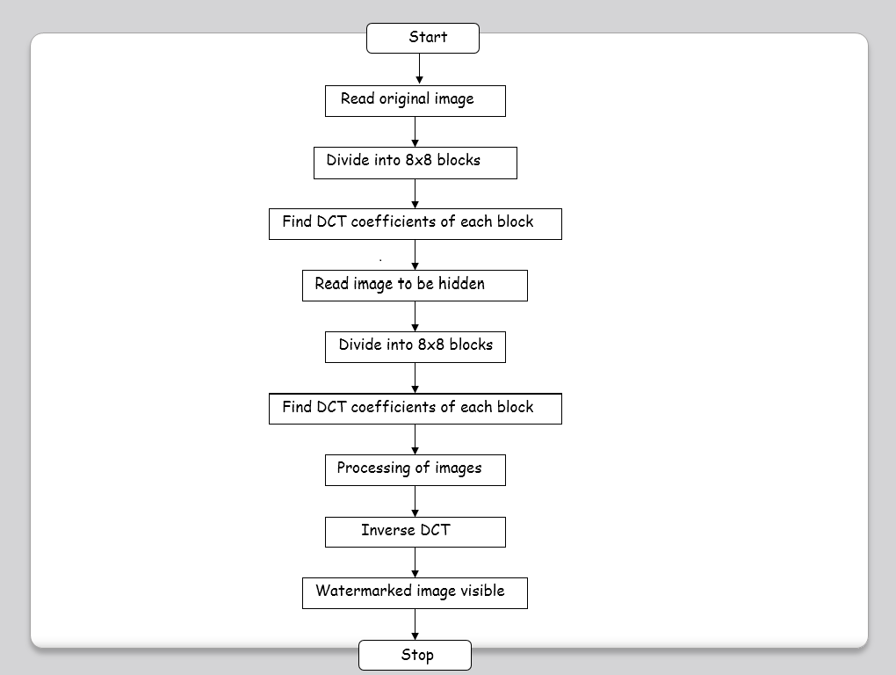

Slide 18
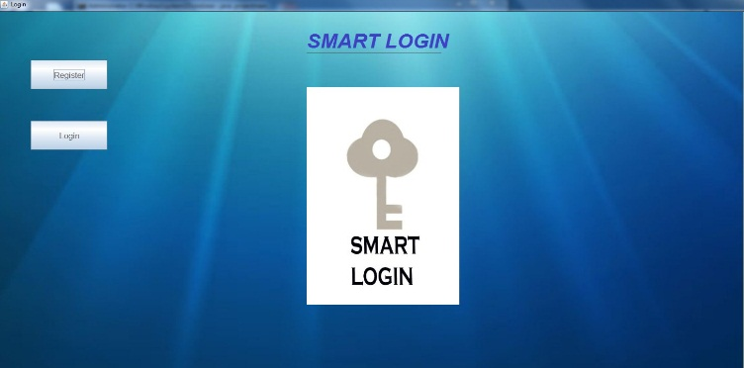
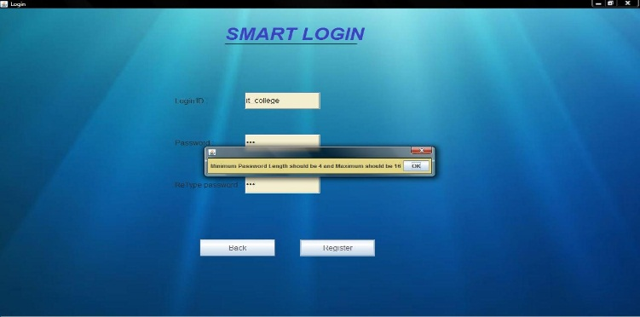
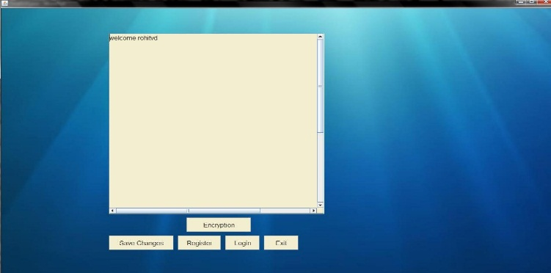
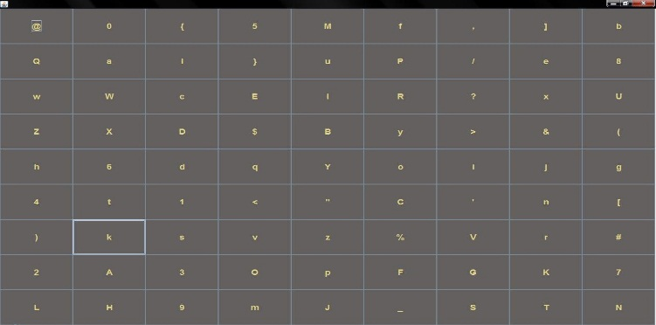
GUI : SMART LOGIN USING WEB SERVICE

Slide 19
Applications Of Project
1. Internet banking for better security system.
2. Mailing portals.
3. In cyber-café to solve the problem of shoulder surfing.
4. Folder locks and PDA’s {data security in mobile phones}
5. Cost-effective way of securing small amount of data, because of the shorter key length used and light computations involved.
6. Useful for encrypting and decrypting characters and/or files (.txt files).
7. It can be used to seal the originality of data.
8. It can be used to hide the confidential images in ordinary images.

Slide 20
Thank you

